Slide 1

K-means clustering (Equally Weighted Portfolio)
Presented by :-
Garvit Kudesia
Harsh Doshi

Slide 2
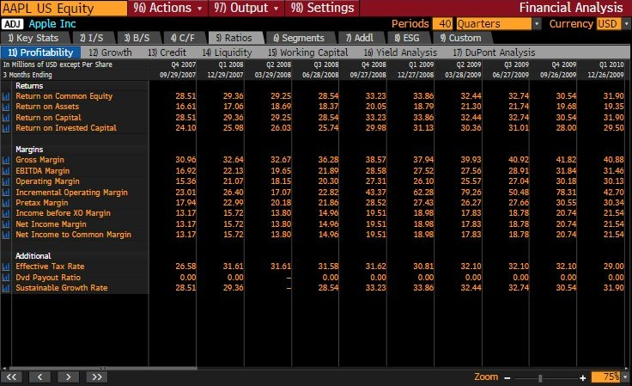
Efficiency Ratios on Bloomberg (Financial Analysis) Return on Assets (Profitability) & Asset Turnover (DuPont Analysis)

Slide 3
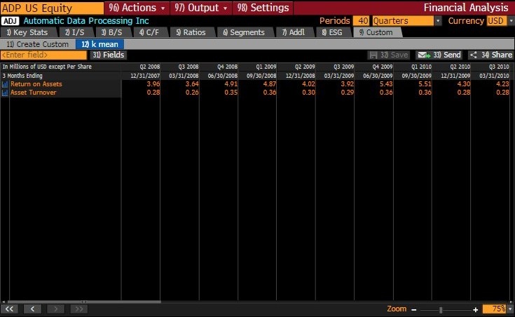
Customized Templates on Bloomberg (Financial Analysis) Return on Assets (Profitability) & Asset Turnover (DuPont Analysis)

Slide 4
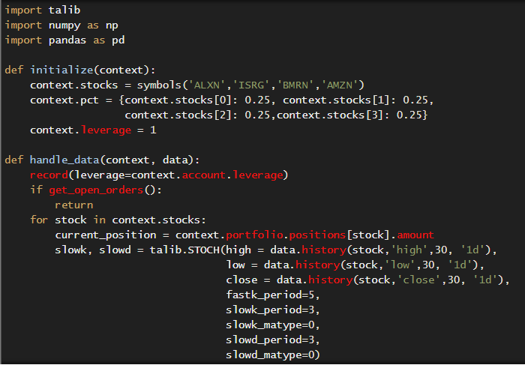
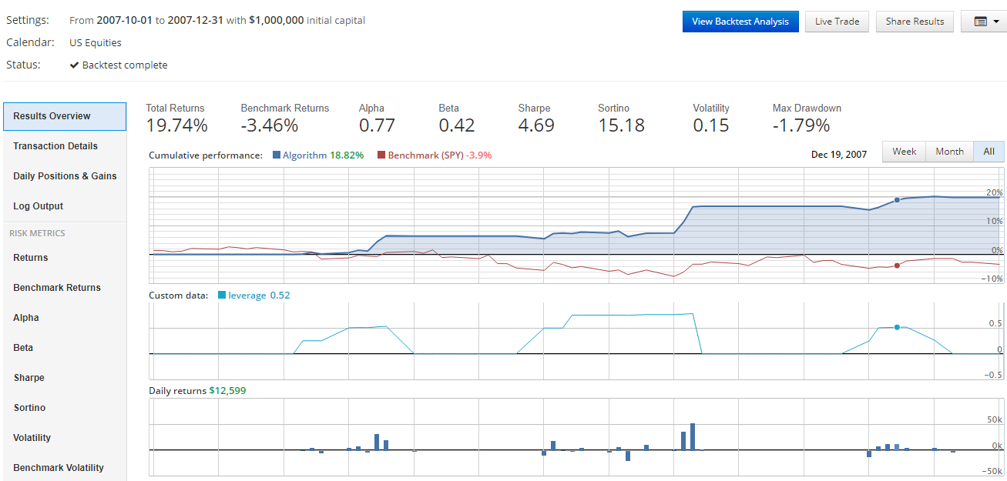
Stress Testing during Q4 2007 (Leverage used 2.0 on Quantopian) Based on signals generated by Stochastic Oscillator

Slide 5
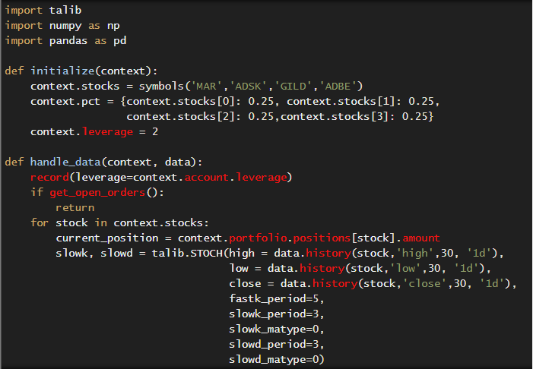
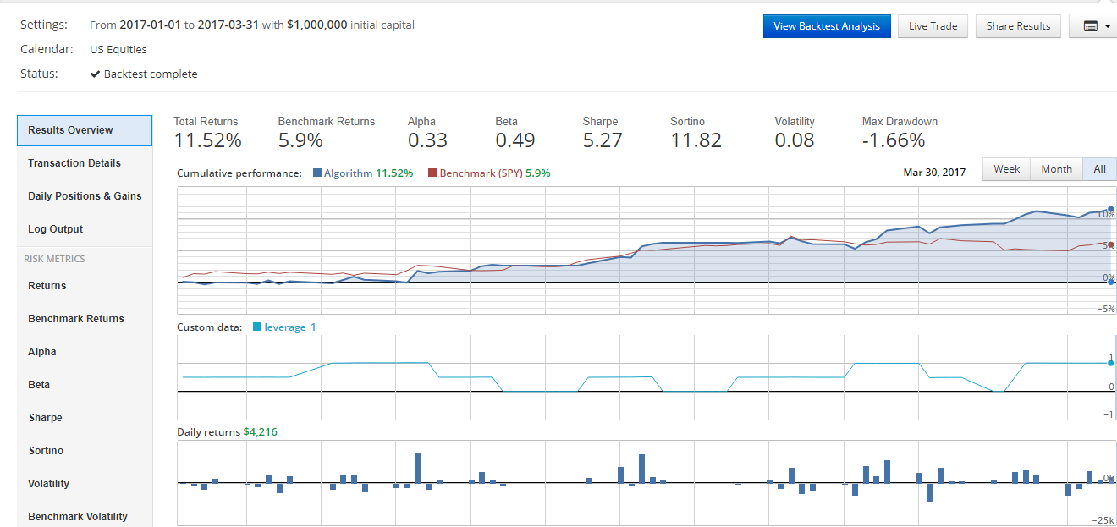
Back Testing during Q1 2017 (Leverage used 2.0 on Quantopian) Based on signals generated by Stochastic Oscillator

Slide 6
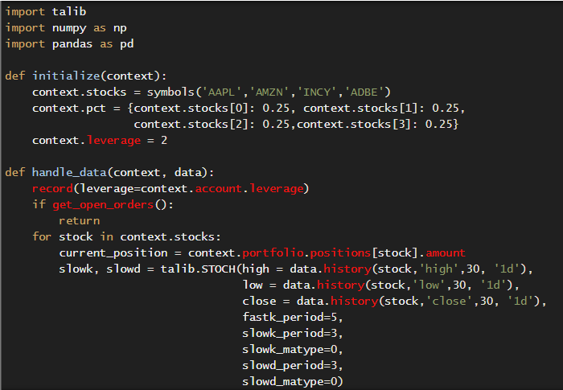
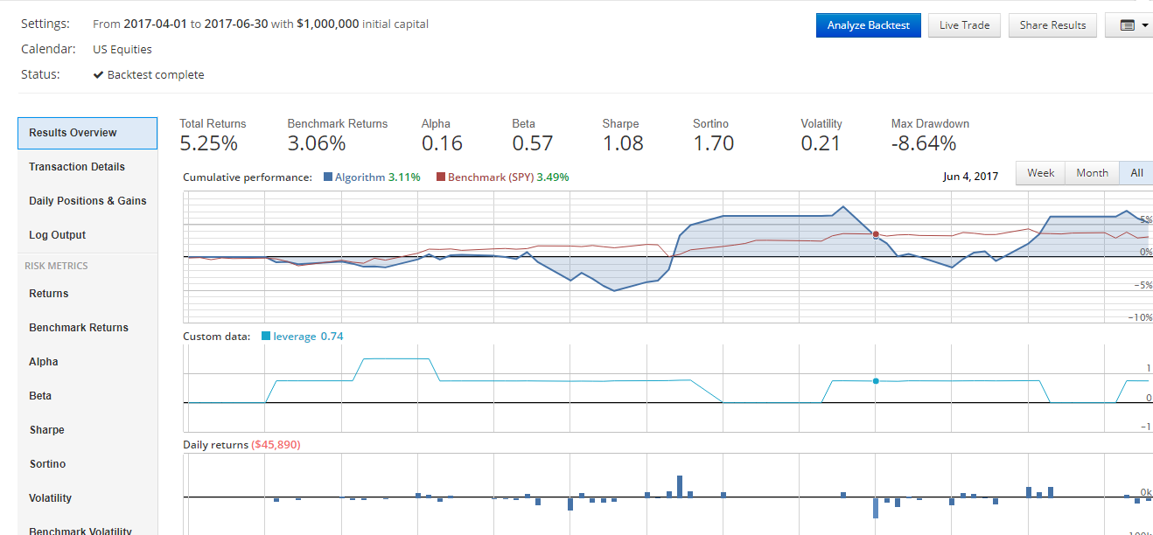
Back Testing during Q2 2017 (Leverage used 2.0 on Quantopian) Based on signals generated by Stochastic Oscillator

